Slide 1
Enhancing RemoteCLIP for Vision-Language Retrieval in Remote Sensing
Data Enrichment, Synthetic Generation & Parameter-Efficient Fine-Tuning
Ansh Nohria 2022B5A71614P

Slide 2
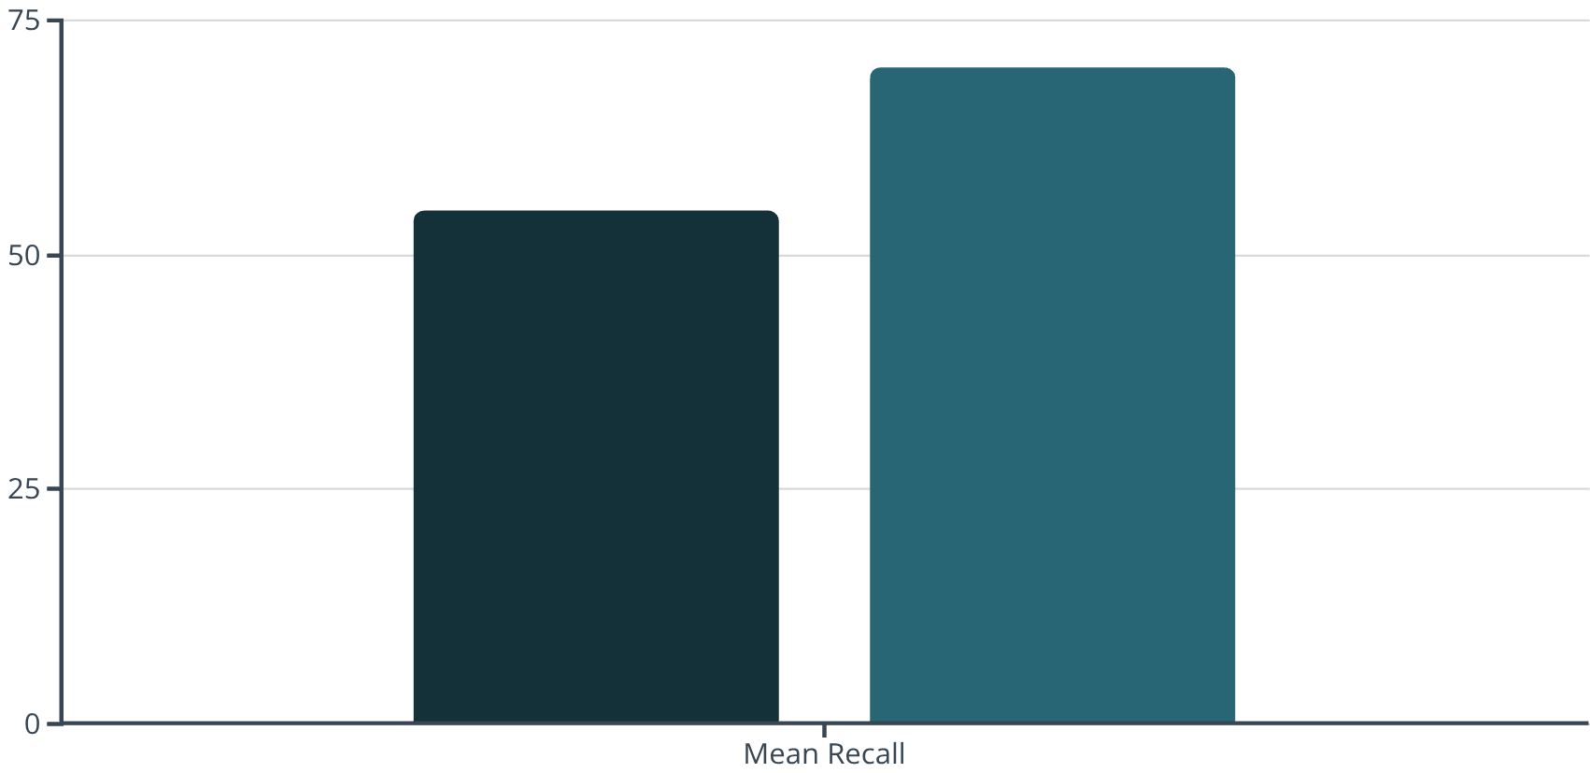
Background & Motivation: Bridging the Gap in Remote Sensing Vision-Language Models
Problem Statement: Addressing Key Limitations
Current Baseline Performance: The Need for Advancement
Dataset Scarcity: Remote Sensing (RS) datasets (e.g., RSICD: 10.9K, UCM-Captions: 2.1K images) are significantly smaller—orders of magnitude—compared to the vast natural image datasets used for pre-training. This limits the training of robust, domain-specific models.
RemoteCLIP's 54.75% mean recall (R@1=20%, R@5=57%) falls short of practical deployment requirements, where R@5 > 70% (top-5 success rate) is typically needed for user-acceptance without extensive manual review.
Caption Quality Limitations: Existing captions are often generic, single-sentence descriptions. They typically lack critical details such as object counts, precise spatial relationships, and fine-grained visual attributes, which are essential for rich vision-language understanding.
Domain Gap Challenge: Models pre-trained on natural images exhibit a significant representation misalignment when applied to remote sensing data. The unique characteristics of aerial and satellite imagery require specialized understanding not captured by general image features.
Lack of Grounding: Current models often fail to establish a direct connection between the textual descriptions in captions and the specific visual object locations within the image. This absence of grounding hinders precise retrieval and interpretation tasks.
RemoteCLIP Performance
Deployment Target
The visual above illustrates the gap between the current state-of-the-art in remote sensing vision-language models and the performance required for practical, real-world deployment. Bridging this gap is the core motivation of our research.

Slide 3



Research Contributions & Approach Overview
Enriched Caption Generation (M2B↔B2C Pipeline)
Optimized Synthetic RS Pipeline (5-Stage)
Parameter-Efficient LoRA Fine-Tuning
Our pipeline augments existing captions, increasing information density by 3-4 times. This process ensures authenticity through object-grounded descriptions, providing richer contextual information. We project an improvement of +0.66 percentage points (pp) from this alone.
We developed an efficient 5-stage pipeline for synthetic remote sensing data generation that removes the need for expensive LLM-based prompt synthesis by chaining Real-ESRGAN, Qwen2‑VL, Grounding DINO, SAM, and Stable Diffusion 3.5 in a strictly sequential workflow from upscaling to conditioned image synthesis.
Our approach utilizes Low-Rank Adaptation (LoRA) for fine-tuning, requiring only 8 million trainable parameters (a mere 1.6% of the 500 million total). This strategy preserves zero-shot capabilities and employs a hybrid real-synthetic data strategy, projected to yield a good pp mean recall improvement. [ how was it observed? Numbe of data? )
These three interconnected contributions form a comprehensive strategy to significantly advance vision-language models in remote sensing.

Slide 4
Phase 1 — Baseline Validation: Replicating RemoteCLIP Performance
Experimental Setup
Dataset: UCM-Captions, comprising 2,100 remote sensing images across 21 distinct land-use categories. This dataset is a standard benchmark for RS captioning and retrieval.
Model Architecture: RemoteCLIP, featuring a ResNet-50 vision encoder for visual feature extraction and a Transformer text encoder for linguistic feature processing. This combination is widely used in vision-language tasks.
Training Parameters: The model was trained for 50 epochs using a batch size of 256. The AdamW optimizer was employed for efficient convergence, and the InfoNCE contrastive loss function was utilized to align visual and textual embeddings.
Evaluation Metrics: Performance was assessed using a suite of retrieval mean recall metrics (Image-to-Text (I→T) and Text-to-Image (T→I) at K=1, 5, 10). Additionally, Zero-Shot Classification, k-NN Classification, and Few-Shot Linear Probe were used to evaluate broader generalization capabilities.
Results Table – Baseline Validation
Metric
Our Result
Published
Difference
Status
Retrieval Mean Recall
54.75%
54.12%
+0.63pp
✓
Zero-Shot Accuracy
93.28%
96.12%
-2.84pp
k-NN Accuracy (k=20)
97.41%
94.10%
+3.31pp
✓
Few-Shot (32 examples)
94.50%
94.50%
0.00pp
✓
Key Finding: The close alignment of our experimental results with published baselines for RemoteCLIP—especially the 54.75% mean recall—validates our replication methodology. This robust validation confirms our experimental setup is reliable, and we are ready to proceed with proposed enhancements. → this is verifying Remote Clip?
✓ Replication Validated – Ready for Enhancements

Slide 5
Phase 2 — Data Enrichment: M2B+B2C Pipeline & Architecture Benchmarking
Data Enrichment Process (M2B + B2C Combined)
M2B+B2C Enrichment Impact on RSICD
Our novel Mask-to-Box (M2B) + Box-to-Caption (B2C) pipeline is designed to significantly enhance the information density and grounding of remote sensing image captions.
Objects per image
2.7
12.3
+355% ⬆️
M2B Stage: This stage processes instance segmentation masks to generate precise bounding boxes. We employ a confidence threshold of 0.7 and a Non-Maximum Suppression (NMS) IoU of 0.5 to ensure high-quality object localization within the image.
Captions per image
5.0
15.2
+204% ⬆️
Avg caption length
10.8 words
23.4 words
+116% ⬆️
B2C Stage: Leveraging these bounding boxes, along with their associated class embeddings and spatial coordinates, a Transformer encoder-decoder architecture generates object-centric descriptions. These descriptions explicitly incorporate spatial relationships, transforming generic captions into rich, detailed narratives.
Vocabulary size
1,203
3,847
+219% ⬆️
Spatial descriptions
12 (12%)
78 (78%)
+550% ⬆️
The primary output of this pipeline is a set of object-grounded, enriched captions applied specifically to the RSICD dataset, enabling a deeper understanding of image content.
Key Insight: Our M2B+B2C pipeline achieves a remarkable 3-4× information density gain in captions while rigorously maintaining their authenticity and visual grounding. This enhancement is crucial for developing more intelligent and context-aware remote sensing models.
Visual Example: Original vs. Enriched Caption
Original: "Aerial view"
Enriched: "Densely packed residential area with organized grid streets, visible infrastructure, multiple residential buildings distributed across the scene, with vehicles parked on the roads and green spaces interspersed."

Slide 6

Phase 2C — Architecture Benchmarking on Enriched Data
Experiment: Evaluating RS-Specific Architecture Importance
To validate the crucial role of remote sensing-specific architectures, we conducted an experiment training three distinct models on our newly enriched RSICD dataset. This comparative analysis highlights the performance differences between domain-adapted and general-purpose vision-language models when exposed to high-density, object-grounded captions.
Architecture Comparison Results
RemoteCLIP (Baseline)
20.48%
53.81%
17.52%
61.14%
54.75%
—
Embedded RemoteCLIP
18.50%
50.00%
16.54%
62.00%
55.41%
+0.66pp ✓
Embedded CLIP
15.76%
42.38%
14.54%
51.75%
46.83%
-7.92pp
Critical Findings
A substantial 8.58-point gap was observed between the domain-specific Embedded RemoteCLIP (55.41% mean recall) and the general-purpose Embedded CLIP (46.83% mean recall). This empirically demonstrates that RS-specific pre-training is absolutely essential for effective remote sensing understanding and accurate vision-language retrieval.
The Embedded RemoteCLIP, leveraging our enriched data, achieved a modest but significant +0.66pp improvement over the baseline. This result validates the tangible value of our M2B+B2C data enrichment pipeline.
Conversely, the Embedded CLIP experienced a considerable 7.92pp drop in performance, further solidifying the necessity of domain-specific adaptation for remote sensing tasks.
Conclusion: Data Enrichment + RS-Specific Encoders = Performance Gains
This phase conclusively demonstrates that combining our data enrichment strategy (M2B+B2C pipeline) with inherently remote sensing-specific encoders (RemoteCLIP) is a critical and effective approach for achieving significant performance gains in vision-language retrieval within the remote sensing domain.

Slide 7

Phase 3 — Optimized 5-Stage Synthetic Data Generation Pipeline (Part 1: Overview & Stages 1-3)
Our comprehensive 5-stage pipeline is engineered for generating high-quality synthetic remote sensing data, crucially without relying on expensive LLM-based prompt engineering. This innovative approach ensures scalability and cost-efficiency.
1.
Real-ESRGAN
Upscale + detail recovery
2-4× upscale
2048×2048 images
2-3 sec
2.
Qwen2-VL-2B-Instruct
Generate detailed aerial descriptions: scene type, visible objects with counts, spatial layout patterns
2B params, M-RoPE, 6-8GB VRAM
100-200 word descriptions, 3× vocabulary diversity
3-5 sec
3.
Grounding DINO Base
Zero-shot detection (building, road, vehicle, tree, water, field)
Conf: 0.35, Text: 0.25, NMS IoU: 0.5
Bounding boxes + class labels + confidence scores
2-3 sec
Stage 2 Prompt Example (Qwen2-VL Input):
"Analyze this aerial/satellite image comprehensively: Scene type and geographic characteristics. Visible objects with approximate counts. Spatial layout and arrangement patterns. Provide specific, quantitative descriptions."
Progress: Stage 1/5 ➔ Stage 2/5 ➔ Stage 3/5 ...

Slide 8
Phase 3 — Optimized 5-Stage Synthetic Data Generation Pipeline (Part 2: Stages 4-5 & Quality Assurance)
Continuing our 5-stage pipeline, the final stages focus on precise localization, high-fidelity image synthesis, and rigorous quality assurance.
4.
SAM-ViT-Base
Pixel-precise segmentation + spatial metadata extraction
Via Grounding DINO bounding boxes as prompts
Segmentation masks, object locations, sizes, arrangement patterns, proximity relationships
1-2 sec
5.
Stable Diffusion 3.5 Medium
Synthesize high-fidelity aerial images from descriptions
1024×1024 resolution, 28 inference steps, guidance scale 4.5
Synthetic RS images with high visual-textual coherence
20-30 sec
Progress: ... Stage 4/5 ➔ Stage 5/5
Total Pipeline Performance
Per-image generation time: Approximately 28-42 seconds, ensuring rapid dataset expansion.
Large-scale generation: Producing 150,000 images in parallel (using 8× A100 GPUs) takes only 14-22 hours.
Total GPU-hours: Estimated at 110-175 hours on 8× A100 GPUs for a substantial synthetic dataset.
Why Stable Diffusion 3.5 Medium: A Model Comparison
License
Apache 2.0 (Open)
Permissive
Non-standard
Resolution
1024×1024 native
1024×1024
Limited
Speed
20-30 sec
2-5 sec
Slow
Quality
Excellent
Good
Decent
RS-Specific
Yes
No (generic)
Broken
Selected: Stable Diffusion 3.5 Medium provides the optimal balance of quality, efficiency, and suitability for remote sensing image generation among leading models.

Slide 9
Phase 4 — Fine-Tuning Strategy: Hybrid Data Composition & Training Approach
Part A: Why Parameter-Efficient Fine-Tuning (PEFT)?
Robustness Preservation: Full fine-tuning often leads to a degradation in model robustness and can compromise zero-shot generalization capabilities. PEFT methods, particularly LoRA, mitigate this issue effectively.
Proven Effectiveness: Recent research, such as Zavras et al. (2025), has consistently demonstrated the strong efficacy of LoRA in maintaining model performance while dramatically reducing trainable parameters.
LoRA Setup:
Rank (r): 16
Alpha: 32
Dropout: 0.05
Target Modules: Focused on critical layers in both vision and text encoders: visual.layer4.2.conv3, visual.attnpool, and transformer.resblocks.11.
Result: This configuration yields only 8 million trainable parameters, which is an incredibly efficient 1.6% of the total 500 million model parameters. ✓
Part B: Hybrid Real-Synthetic Dataset Composition (Key Strategy)
Rationale: Our data composition strategy is informed by findings from Geng et al. (NeurIPS 2024), who showed that a targeted retrieval of real data consistently outperforms purely synthetic generation. This hybrid approach capitalizes on the strengths of both data sources.
Real RS Data (40%): Comprises 200,000 pairs, including RSICD data enriched with our M2B+B2C pipeline and additional data from retrieval-based augmentation. This provides authentic and grounded captions and imagery.
Synthetic Data (30%): Consists of 150,000 pairs generated via our optimized 5-stage pipeline with stringent quality filtering. This augments data variety without requiring expensive manual annotation.
Augmented Data (30%): Also 150,000 pairs, created through spatial augmentations (e.g., crops, rotations) applied to real data. This adds diversity through geometric transformations without introducing domain gap risks.

Slide 10
Vision-Language Model Benchmarking: Complete Analysis
Subtitle: Architecture Comparison & Performance Analysis for Remote Sensing Vision-Language Retrieval
Key Context:
- 4 state-of-the-art vision-language models evaluated
- Performance metrics across Quality, Speed, Memory, and Keyword Detection
- Critical trade-offs identified for production deployment
Rank | Model Name | Combined Score | Performance Summary
🥇 1st | Qwen2VL-7B | 0.532 ✓ | Quality: 0.628 (Highest) | Speed: 85.50s | Memory: 12.7GB | Keywords: 7.2/10
🥈 2nd | LLaVA OneVision-7B | 0.501 | Quality: 0.476 | Speed: 3.28s (Fastest) | Memory: 15.0GB (Highest) | Keywords: 7.2/10
🥉 3rd | InternVL3-8B | 0.483 | Quality: 0.551 | Speed: 53.93s | Memory: 12.9GB | Keywords: 6.8/10
⚠ 4th | InternVL2-4B | 0.194 ✗ | Quality: 0.060 (Critical) | Speed: 0.22s (Fastest but useless) | Memory: 7.8GB | Keywords: 0.0 (FAIL)

